Slide 1

高端作业-5
KK

Slide 2

Contants
01
02
03
04
Select问题分析
NIOAcceptor非阻塞
telnet服务
bufferPool问题

Slide 3
MyNIORector 这里的selector.select(500); 如果改为selector.select()，会是什么结果，结合
socketChannel.register(selector, SelectionKey.OP_READ)这里的JavaDoc，研究说明问题所在

Slide 4



ADD TITLE
ADD SUBTITLE
It was the best of times, it was the worst of times; it was the age of wisdom, it was the age of foolishness.
It was the best of times, it was the worst of times; it was the age of wisdom, it was the age of foolishness.
It was the best of times, it was the worst of times; it was the age of wisdom, it was the age of foolishness.

Slide 5
ADD TITLE
ADD SUBTITLE
NEIMENGGU
It was the best of times, it was the worst of times; it was the age of wisdom, it was the age of foolishness.
It was the best of times, it was the worst of times; it was the age of wisdom, it was the age of foolishness.

Slide 6

PART
TWO
Copyight @2014 wechat damen_ppp lnc
All Rights Reserved

Slide 7
ADD TITLE
ADD SUBTITLE
It was the best of times, it was the worst of times; it was the age of wisdom, it was the age of foolishness.

Slide 8
ADD TITLE
ADD SUBTITLE
It was the best of times, it was the worst of times; it was the age of wisdom, it was the age of foolishness.
56%
45%
40%
It was the best of times, it was the worst of times; it was the age of wisdom, it was the age of foolishness.
30%
It was the best of times, it was the worst of times; it was the age of wisdom, it was the age of foolishness.
It was the best of times, it was the worst of times; it was the age of wisdom, it was the age of foolishness.
A
B
C
D
TEXT

Slide 9
ADD TITLE
ADD SUBTITLE
A
It was the best of times, it was the worst of times; it was the age of wisdom, it was the age of foolishness.
B
It was the best of times, it was the worst of times; it was the age of wisdom, it was the age of foolishness.

Slide 10
ADD TITLE
ADD SUBTITLE
It was the best of times, it was the worst of times; it was the age of wisdom, it was the age of foolishness; it was the epoch of belief, it was the epoch of incredulity; it was the season of light, it was the season of darkness.
It was the best of times, it was the worst of times; it was the age of wisdom, it was the age of foolishness; it was the epoch of belief, it was the epoch of incredulity; it was the season of light, it was the season of darkness.
TEXT

Slide 11
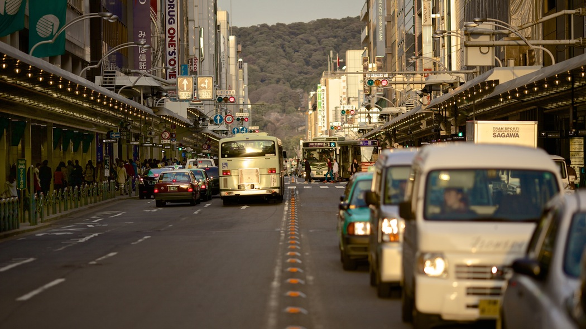
PART THREE
Copyight @2014 wechat damen_ppp lnc
All Rights Reserved

Slide 12
TEXT
It was the best of times, it was the worst of times; it was the age of wisdom, it was the age of foolishness.
It was the best of times, it was the worst of times; it was the age of wisdom, it was the age of foolishness.

Slide 13
ADD TITLE
ADD SUBTITLE
TEXT
TEXT
It was the best of times, it was the worst of times; it was the age of wisdom, it was the age of foolishness.
TEXT
It was the best of times, it was the worst of times; it was the age of wisdom, it was the age of foolishness.
It was the best of times, it was the worst of times; it was the age of wisdom, it was the age of foolishness.

Slide 14
ADD TITLE
ADD SUBTITLE
It was the best of times, it was the worst of times; it was the age of wisdom, it was the age of foolishness.
1
2
It was the best of times, it was the worst of times; it was the age of wisdom, it was the age of foolishness.
It was the best of times, it was the worst of times; it was the age of wisdom, it was the age of foolishness.
3
4
It was the best of times, it was the worst of times; it was the age of wisdom, it was the age of foolishness.

Slide 15

Thanks.
Copyight @2014 wechat damen_ppp lnc
All Rights Reserved

Slide 16
R
DAMEN PPT

